Slide 1

Competition Law in India
21 January 2016
J. Sagar Associates
advocates & solicitors
Ahmedabad | Bengaluru | Chennai | Gurgaon | Hyderabad | Mumbai | New Delhi

Slide 2
Main Elements
Prohibits anti-competitive agreements (Section 3)
Prohibits abuse of dominant position (Section 4)
Regulates combinations - merger, acquisition and amalgamation (Sections 5 & 6)
Competition advocacy – education of stakeholders and influencing policy makers (Section 18)

Slide 3
Session 1: Anti-competitive Agreements

Slide 4
Agreements (1/5)
‘Agreement’ includes:
  any arrangement or understanding or action in concert
  formal or informal, written or oral agreements
  agreements which may not be meant to be legally enforceable
  Wide meaning given to ‘Agreement’:
  In re: Aluminum Phosphide Tablets Manufacturers (Suo-motu Case No. 02/2011)
  Reliance Big Entertainment Limited v Karnataka Film Chamber of Commerce and Ors. (Case No. 25, 41, 47, 48, 50, 58 and 69 of 2010)

Slide 5
Agreements (2/5)
  The existence of an agreement must be established unequivocally:
  In re All India Tyre Dealers Federation v Tyre Manufacturer (Case RTPE No. 20 of 2008)
  Neeraj Malhotra v Deutsche Post Bank Home Finance Limited & Ors (Case No. 5/2009)
  Agreements in respect of production, supply, distribution, storage, acquisition or control of goods or provision of services, which cause or are likely to cause an appreciable adverse effect on competition (AAEC) are anti-competitive – prohibited by law and are void

Slide 6
Section 19(3) factors (3/5)
Factors u/s 19(3) considered for determining AAEC:
Anti-competitive factors:
  creation of barriers to new entrants in the market;
  creation of contractual barriers – high license fee charged by a patent holder
  driving existing competitors out of the market;
  termination of agreement

Slide 7
Section 19(3) factors (5/5)
  foreclosure of competition by hindering entry into the market;
  manufacturer entering into an exclusive agreement with the only component supplier in the market
  Pro-competitive factors: For e.g. - an agreement (vertical integration of a supplier with a manufacturer) enhancing cost efficiency – resulting in lower prices
  accrual of benefits to consumers;
  improvements in production or distribution of goods or provision of services;
  promotion of technical, scientific and economic development by means of production or distribution of goods or provision of services.

Slide 8
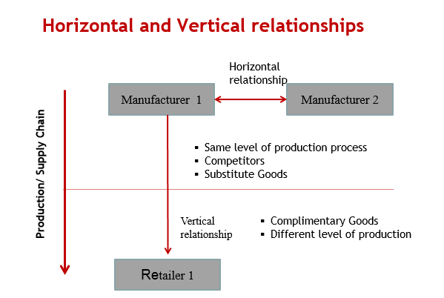
Types of Agreements

Slide 9
Horizontal Agreements (1/4)
Agreement between entities at the same level of production chain:
  Example - agreement between two or more producers; or an agreement between two or more retailers
presumed to have AAEC in India; rebuttable presumption
applies to agreements for price fixing, controlling output, market sharing, collusive bidding or bid rigging.
Exemption for efficiency enhancing joint ventures
Many facets of efficiencies: dynamic, static, x – efficiency

Slide 10
Horizontal Agreements (2/4)
Cartels - type of horizontal agreement - association of producers/sellers/distributors/ traders or service providers who, by agreement amongst themselves limit control or attempt to control the:
production, distribution, sale or price of, or trade in goods or provision of services
  Cartels - most pernicious form of anti-competitive activity; presumption of AAEC; more severe fines (cement cartel – 0.5 times the profit – INR 6300 crores)

Slide 11
Horizontal Agreements (3/4)
  Standard of proof:
  credible circumstantial evidence in the absence of direct evidence - Builders Association of India v. Cement Manufacturers' Association & Ors – Cement cartel case (Case No. 29 of 2010)
  balance of probabilities and liaison of intention test – can be established with the help of indirect and circumstantial evidence- In Re: suo‐motu case against LPG cylinder manufacturers (Case No. 03 of 2011)
Role of trade associations - facilitators of potential cartel?
Cement cartel case – CMA provided opportunity to discuss and determine prices - held as sufficient evidence to suggest cartelization

Slide 12
Horizontal Agreements (4/4)
  Methodology for detection:
  complaints/information submission
  leniency application

Slide 13
Vertical Agreements (1/2)
Agreement between entities at different levels of production chain
  Example – Agreement between a manufacturer and a retailer
    No presumption of AAEC
    Requirement of defining the relevant market? – no provision in the Act
Inclusive list of vertical restraints
Tie-in Arrangement
  Forcing customers to buy ink with pen

Slide 14
Vertical Agreements (2/2)
Exclusive Supply Agreement
  Wholesaler forces retailer to procure all its supplies from the wholesaler
Exclusive Distribution Agreement
  Single distributor for a territory
Refusal to Deal
  A dealer disallowed from dealing in competing brand of cars
Resale Price Maintenance
  Wholesaler dictating the price to retail seller

Slide 15
Exemptions
Reasonable restrictions necessary to safeguard rights arising out of intellectual property laws provided under Section 3(5)
  What is reasonable? - not defined under the Act
  Not exempted from abuse of dominant position provisions
Anti-competitive agreement meant exclusively for export.
Agreements between enterprises within the same group or constituting a single economic entity excluded from the purview of the Act [Exclusive Motors Pvt. Ltd. v. Automobili Lamborghini S.P.A, Case No. 52 of 2012]

Slide 16
Case A: Section 3 (1/2)
Cement Cartel Case (Builders Association of India vs Cement Manufacturers' Association & Ors - Case No. 29/ 2010)
The CCI penalised ten cement manufacturers for operating a cartel in the cement industry. The CCI took into consideration the following, while imposing penalty:
Cement Manufacturers’ Association (CMA): cement companies met using the platform of CMA – provided an opportunity to determine and fix prices;
Price-parallelism: economic analysis of the price data indicated strong positive correlation in the prices of cement companies;
Capacity utilization: increase in capacity utilization, production did not increase commensurately;

Slide 17
Case A: Section 3 (2/2)
Production parallelism: strong positive correlation shown – indication of coordinated behaviour;
Dispatch parallelism: – identical dispatches made by the cement companies;
Increase in prices: deliberate act of withholding production and supplies by the cement companies – resulted in higher prices;
High profit margins: cement companies earned huge margins over cost of sales; and
Price leadership: price leaders gave price signals through advanced media reporting – easier for other manufacturers to co-ordinate their strategies.

Slide 18
Session 2: Abuse of Dominance

Slide 19
What is Dominance?
Dominance not anti-competitive; abuse is
Dominance of an “enterprise”:
  ability to behave independent of competitive forces;
  affects competitors or consumers in its favor;
  13 factors under Sec. 19(4)
Dominance in a “relevant market”
RM = RPM + RGM
  RPM = Coke and Fanta?
  RGM = South Delhi or NCR?
Notes:
Relevant Market
Section 2(r): RM = RPM + RGM
Section 2(s): RGM = “market comprising area in which the conditions of competition for supply of goods or provision of services or demand of goods or services are distinctly homogenous and can be distinguished from the conditions prevailing in the neighbouring areas”

Slide 20
Section 19(4) Factors (1/2)
Market share
EU – 40% indicative of dominance
Absolute and relative size; economic power
Financial strength
Non-financial strength (IPRs, production capacity)
Market structure
Oligopoly, nature of demand (elastic/inelastic)
Commercial advantages over competitors
Costs, IPRs, technology
Dependence of consumers
Notes:
Relevant Market
Section 2(r): RM = RPM + RGM
Section 2(s): RGM = “market comprising area in which the conditions of competition for supply of goods or provision of services or demand of goods or services are distinctly homogenous and can be distinguished from the conditions prevailing in the neighbouring areas”

Slide 21
Section 19(4) Factors (2/2)
Vertical Integration
Statutes resulting in dominance/monopoly
Indian Railways? [Arshiya]
Entry barriers
Regulatory
Contractual
Countervailing buyer power
enterprise with a high market share may not be dominant – in case of high countervailing power
[Kornsas AD Cartonboard COMP/M. 4057]
Social obligations and costs
Notes:
Relevant Market
Section 2(r): RM = RPM + RGM
Section 2(s): RGM = “market comprising area in which the conditions of competition for supply of goods or provision of services or demand of goods or services are distinctly homogenous and can be distinguished from the conditions prevailing in the neighbouring areas”

Slide 22
Abuse of Dominance (1/2)
Imposing unfair/discriminatory condition or price:
  Commercially onerous
  Favourable terms to affiliate companies
  Excessive/predatory pricing
Limiting/restricting production or scientific development:
  Adverse impact on innovation in a RM
  Adverse impact on competitors’ output

Slide 23
Abuse of Dominance (2/2)
  Denial of market access
  Creating barriers which increase cost of entry
  Contractual restrictions (selective licensing)
  Imposing supplementary conditions – no relation to subject matter of contract
  Commercially onerous
  Leveraging dominance
  Dominance in a RM abused to enter/protect in another RM
  ‘Protect’ – defensive leveraging

Slide 24
Case B: Abuse of Dominance (1/3)
NSE-MCX case (Multi Commodity Exchange (MCX) v. National Stock Exchange (NSE) - Case No. 13/2009)
Relevant Market: stock exchange services in the CD segment in India, cluster market not considered – consumer preference
  SSNIP test (‘Hypothetical Monopoly Test’) – not applicable as:
    CD segment did not exist prior to August 2008;
    transaction/data fee – not been charged by any other market player since inception; and
    transaction fee etc. insignificant to constitute substitutability.

Slide 25
Case B: Abuse of Dominance (2/3)
Dominant Position:
  Market share (in CD segment) analysis
    DG findings – NSE 47-48%; MCX-SX 52-53%
    CCI findings – NSE 30%; MCX-SX 34%; USE 36%
  Despite low mkt. share and new entrant – CCI held NSE dominant
  Evaluation of strength based on:
    Not just mkt. share – but comparative advantages in terms of financial resources, technical abilities, brand value, historical legacy

Slide 26
Case B: Abuse of Dominance (3/3)
Pricing:
  CCI investigated the zero price policy of NSE i.e. waiver of fees relating to transaction and admission
  NSE did not collect annual subscription charges, provided data feed w.r.t CD segment for free
  CCI – zero price policy of NSE unfair:
    MCX-SX only in CD segment – no other income;
    MCX-SX & NSE not equal – resources, nationwide presence etc.
Leveraging:
  CCI – NSE cross subsidized ‘monopoly’ position in non-CD segment – to acquire dominant position in the CD segment

Slide 27
Penalty (1/2)
Section 27:
  Upto 10% of average turnover for the last 3 years
  Upto 3 x profit OR 10% turnover (whichever is higher) for each year of cartelization [doctrine of disgorgement]
  Total or relevant turnover?
  (Excel Corp.; United Phosphorous – Compat)
No guidelines on determination of penalty

Slide 28
Penalty (2/2)
Section 48
Penalty on individuals
“Shall be proceeded against and punished accordingly” – Turnover of individuals?
Any person found guilty of an offence (imprisonment or fine > INR 1000) under the Competition Act - disqualified to be appointed as a director under Schedule V of the Companies Act, 2013

Slide 29
Non - Compliance
Penalty for non-compliance (S. 42):
Fine up to INR 1 lakh for each day of non-compliance (maximum of INR 10 crores)
Failure to pay above stated fine:
Imprisonment up to 3 years, or
penalty up to INR 25 crores, or
both
as the Chief Metropolitan Magistrate, Delhi, may deem fit.

Slide 30
Remedies
Remedies
  Cease and desist
  Structural remedies (Divestiture)
  Behavioural remedies (Licensing)
  Compliance Programmes
Competition authority cannot direct an enterprise to deal with a competitor
“a trader or manufacturer engaged in an entirely private business, is free to exercise his own independent discretion as to the parties with whom he will deal” [United States v Colgate & Co. 39 S.Ct 465 (1919)]
Verizon Communications v. Law Offices of Curtis v Trinko LLP [540 US 398 (2004)]

Slide 31
Session 3: Merger Control

Slide 32
Section 5: Combinations (1/2)
Transactions which exceed prescribed thresholds
  acquisition of control, shares, voting rights or assets;
  mergers and amalgamations

Slide 33
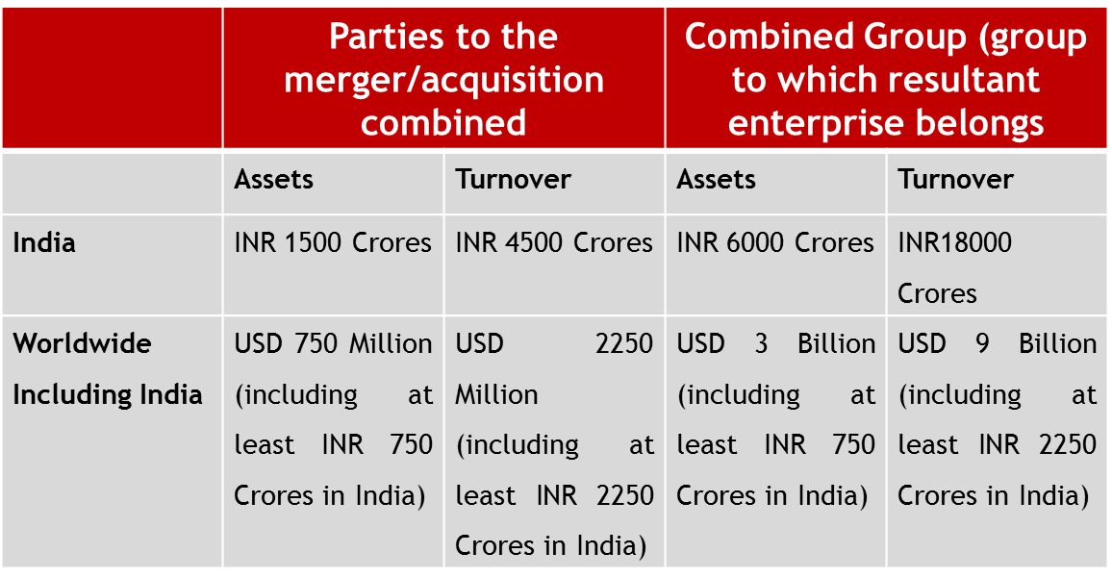
Section 5: Combinations (2/2)
Small Target Exemption – Acquisitions where the target entity has assets in India not exceeding INR 250 crores or turnover in India not exceeding INR 750 crores are exempt, valid till 3 March 2016.

Slide 34
Case C: Combination (1/3)
Holcim-Lafarge merger
(Notice given by Holcim Limited and Lafarge S.A.
C-2014/07/190)
RPM:
“market for grey cement”
RGM:
“market for the Eastern region may be defined in terms of area comprised by the states of Chhattisgarh, Odisha, West Bengal, Bihar and Jharkhand.”

Slide 35
Case C: E - H Test (2/3)
RGM determined using Elzinga Hogarty test
Two measurements – LIFO and LOFI
LIFO
1 – Shipments from plants in area to inside ≤ 0.1
Production in candidate area
LOFI
1 - Purchases by consumers in an area ≤ 0.1
Production in candidate area
Notes:
EH test uses aggregate inflow/outflow of consumers (import/export of goods) to determine RGM. The boundaries of RGM is expanded till inflow and outflow are below a cut-off level. The cut off level is usually 10% of total sales.
EH test has 2 measurements. First, determining the geographic area responsible for a percentage of sales. Elzinga and Hogarty originally suggested an area responsible for 75 percent of sales, and later suggested 90 percent for a “strong market” and 75 percent for a “weak market”. This area is sometimes called the service area/ draw area/ catchment area. The measure of the service area is the Little In From Outside (LIFO) measure.
The second measurement is the percentage of residents in the service area who put their demand within the area. This is called the Little Out From Inside (LOFI) measure. This takes into account the consumers who would put their demand outside the service area in case there is increase in price of product/service demanded.

Slide 36
Divestiture ordered (3/3)
WHAT?
2 cement plants of Lafarge located in RM (Eastern Region)
Jojobera (Jharkhand)
Sonadih (Chhatisgarh)
WHY?
Increase in concentration in RM
HHI = 625
CR4 = 72%
Post-divestiture
HHI = 133
CR4 = 65% - 70%

Slide 37
Questions?

Slide 38
THANK YOU
amitabh.kumar@jsalaw.com

